Slide 1
Artificial Intelligence
Personal Assistant

Slide 2
Introduction:
Computer to understand human intelligence.
Founded field of AI research as an academic discipline in 1956.
Today’s virtual personal assistance are
Siri - iPhone
Google Now - Google
Cortana- Microsoft
Alexa – Amazon
Jarvis – Mark Zuckerberg

Slide 3
Use of AI:
Voice interface to make quotidian task easier.
Siri, Cortana and Goggle Now that are being used for weather forecast and more complex task like managing calendar or answering your queries.
Mark Zuckerberg presents a simple AI called “Jarvis” that provide calendar briefings, entertain her daughter Max in Mandarin, identify and let people into his home, control the lights and play music.
AI as personal assistants are re-allocating all of those hours of wasted productivity doing email back-and-forth back to deep work, booking travel, managing your receipts, and repetitive sales tasks are among the plethora of chores we must do everyday.

Slide 4
How communicates AI
All AI has it’s own Algorithms set inside of It
Siri – DSP(digital signal processing) –DTW(Dynamic time Rapping)
Alexa – NLP (Natural Language Processing)

Slide 5
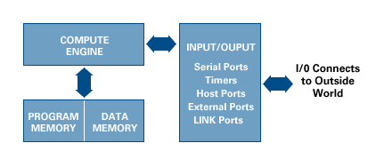
What is DSP?
A DSP(Digital Signal process): contains
Program Memory: Stores the programs the DSP will use to process data
Data Memory: Stores the information to be processed
Compute Engine: Performs the math processing, accessing the program
from the Program Memory and the data from the Data Memory
Input/Output: Serves a range of functions to connect to the outside world

Slide 6
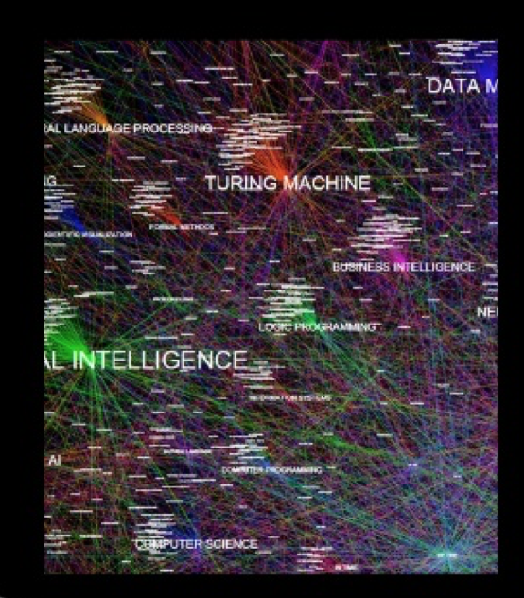
Natural Language Processing(NLP)

Slide 7
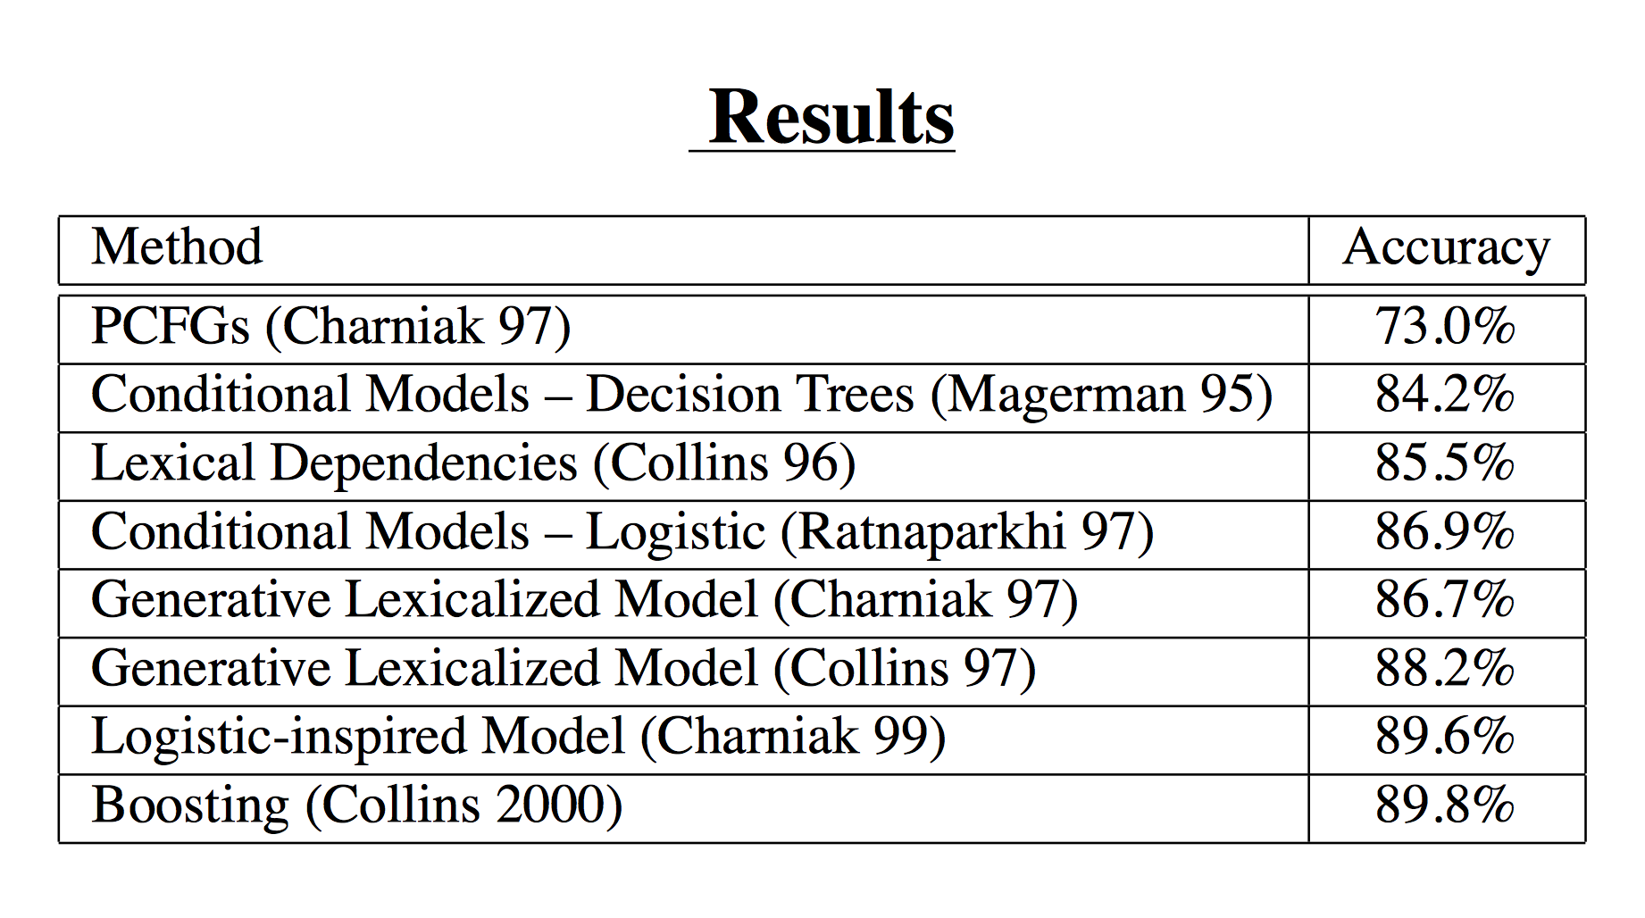
Data and Result

Slide 8
Conclusion:
The problem with AI is it seems like magic!
Some people say strong AI is possible other denies it
AI is central theme in many fictional fantasy films and book genres
“Every aspect of our lives will be transformed. In short, success in creating AI could be the biggest event in the history of our civilization.” - Stephen Hawking

